Slide 1
Space War
Project Internship partime HIN019
Hoàng Đình Tuấn

Slide 2

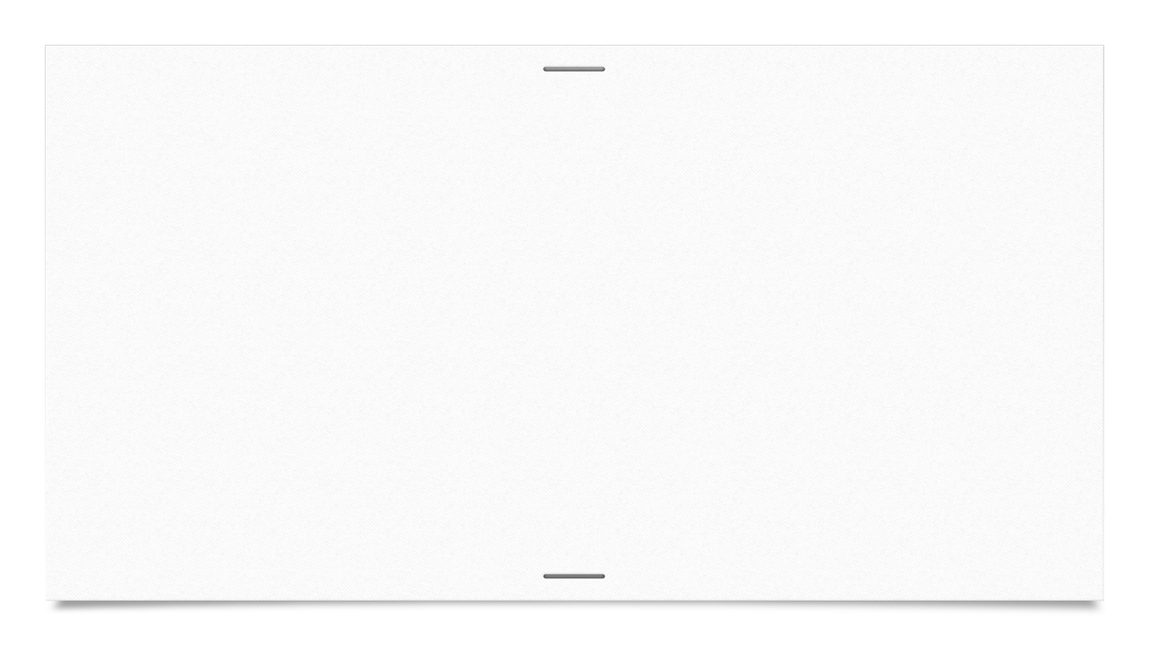

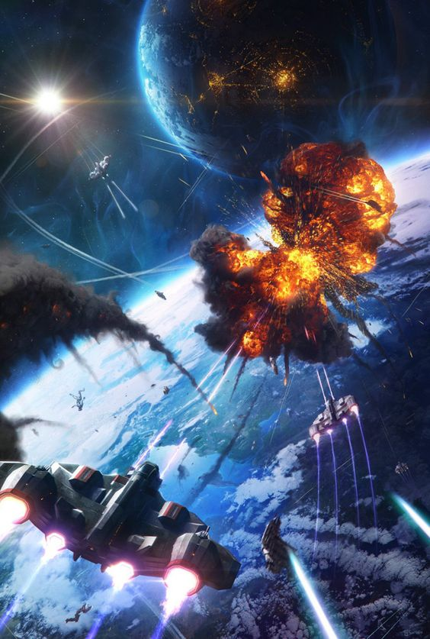
Space War
Category : space fighter, spaceship
Idea: Chiến cơ huyền thoại, template

Slide 3
Resources
Template, Github, …
Pointer, smart pointer, Soloud, C++ - OOP

Slide 4
GamePlay
Control a spaceship
Fight against enemy from outer space – an Army
Lots of enemy
Boss

Slide 5
Rules
Kill normal enemy to get point
Enough point (25) : Boss appear
Kill the boss to win

Slide 6
Feature
Player - spaceship
HP
Bullet – damage
Moving under control
Mission :
Kill the boss and as many enemies as possible
Survival

Slide 7
Enemy
Normal Enemy
Moving randomly
Bullet – damage
Collision
Boss
Attack rapidly
Multiple bullet
Big, Dangerous

Slide 8
Development Potential
Player:
New ship
New bullet, different damage
Enemy
Endless
Stronger by time
Game Play
Many game mode
Endless
Escape

Slide 9



